Slide 1
HCI Principles
IUM 2024/2025

Slide 2
people are complex
individual differences: ≠ thinking styles, ≠ interaction strategies
parallel processing: people may handle ≠ jobs at the same time - how can we use this?
expert systems: it is convenient to view the mind as an expert system: LTM a body of rules, STM a blackboard, the number of goals is limited, access to rules in LTM increases their probability of future access...
wider issues: motivation, stress, play, environment affect the user and therefore his attitudes

Slide 3
skill/rule/knowledge
3 levels of abstraction
skill-based performance runs without conscious attention or control, e.g. typing for a typist - it works only if the user's control model is an adequate representation of the interface
rule-based performance is the recollection of skilled behaviour patterns
knowledge-based behaviour is used for an interaction poorly rehearsed so that rules have not been developed - goals must be explicitly formulated in order to work out a plan
The system will favour the transition from knowledge-based to
skill-based user behaviour
Notes:
In relation to the user’s mind as expert system…

Slide 4

symbolic/atomic/continuous
three human modes ≡ the interface styles
symbolic - textual commands with non-trivial syntax, example:
delete *.txt (operation) (expression)
evaluating to a list of file names ending in .txt
but this will be executed only after the user will press
enter
to finally perform the delete operation.
Symbolic interfaces are often extensible
atomic - special purpose keys, perceived and executed immediately, trivial syntax, either succeed completely or have no effect, quantified, no composition available (menu interfaces are atomic)

Slide 5
last mode
continuous - using continuous input devices like a light pen, mouse, joystick with fast visual feedback for effective use - eye, finger, hand or arm movement even body
selection-oriented, they support atomic input style, also used for supplying parameters to a symbolic interface
A soft keyboard (an on-screen keyboard) allows users to input characters that might not be available on a physical keyboard, such as those from extended character sets (e.g., accented letters or special symbols).

Slide 6
interface styles, other differences
each style is distinct, but can emulate the other two - a real interactive system will mix them all - incremental interaction is based on the atomic style - a symbolic style is supported using a timesharing system - like in banks - ideal for mainframes
once a symbolic command is entered it may entail an arbitrary amount of number crunching without providing feedback to the user - only the final result (a receipt) -
an atomic interface requires feedback to the user per stroke (about 10/second) needing more computing power
a continuous interface requires a real-time response, the cursor must keep up with a pointing device, sometimes the user wants to move/rotate an object and more computing power is required like with a workstation or a dedicated personal computer

Slide 7
trade/offs
error in a symbolic interaction results in losing the submission - it may be recovered depending on the user's LTM
a system may provide naming as a way of expediting chunking - the user may remember the name in LTM more easily -
error in an atomic interaction causes a single action to be lost, recovery depends on STM, if the error is not reported soon enough, it may be lost from STM
errors in a continuous interaction arise continuously...and the user keeps correcting them, these systems are reversible since over-shoots and under-shoots often occur
if the feedback is fast (per-action) we have reactive systems
which include the interactive ones
Notes:
Naming for Chunking: Naming is a technique used in symbolic interactions to expedite chunking, which involves grouping related information or objects together. Providing names for items or concepts can make it easier for users to remember and manage them.
LTM and Naming: Users may remember these names more easily in their Long-Term Memory, which aids in efficient retrieval and interaction.
Example: In a file management system, if users can provide custom names for files or folders, they can quickly identify and access the items they need.

Slide 8
linguistic aspects
lexical form of commands/form of output symbols
syntactic combination rules of previous commands
semantic what do these combinations mean
When an interface processes the input, the lexical level is associated to the way symbols are presented on the screen by the system (colours, windows, widgets, menus, icons, etc.) while the syntactic level is tied to the rules for generating such visual symbols, for displacing windows, for positioning them and managing screen estate, for rotating, enlarging, etc. all displayed symbols; finally the semantic level cannot be defined with a-priori rules but is strictly conditioned by the tasks that must be executed.
Notes:
1. Lexical Level
Lexical Form: The lexical level deals with the form of commands and the form of output symbols in the user interface. This level is concerned with the visual representation of elements in the interface, such as colors, windows, widgets, menus, icons, and other symbols.
User Perception: It involves how users perceive and interpret these visual symbols presented on the screen. Lexical elements are the building blocks that users see and interact with in the interface.
2. Syntactic Level
Syntactic Rules: The syntactic level focuses on the combination rules for the previous commands and visual symbols in the interface. It deals with how these elements can be structured and combined.
Layout and Structure: At this level, designers establish rules for generating and arranging visual symbols, including how to displace windows, position them on the screen, manage screen real estate, apply transformations (e.g., rotation or enlargement), and define the overall layout and structure of the interface.
Structural Consistency: Ensuring consistency in the layout and structure of the interface is essential at the syntactic level to make it predictable and user-friendly.
3. Semantic Level
Semantic Meaning: The semantic level pertains to the meaning and interpretation of the combinations of visual symbols and user commands in the interface.
Task-Dependent: Unlike the lexical and syntactic levels, which can be defined with rules and standards, the semantic level is highly task-dependent. It is specific to the tasks that users need to execute within the interface.
Task Understanding: Users must understand the semantics of the visual symbols and commands to effectively interact with the system, and this understanding depends on the context and purpose of their actions.

Slide 9
errors
all these levels are interwoven...to find out the useful levels HT suggests to distinguish them on the basis of how they fail to work in a program, i.e. how long it takes to detect an error and what are its consequences
lexical errors can be detected almost immediately - next syntactic errors may be located after checking the rules, finally, semantic errors can be found: the first error is easy to recover from (just submit the correct lexeme), the second one may have propagated backwards and forwards but the system just reports it, finally the last error (semantic one) may have drastic consequences since an action was performed which was not the intended one.

Slide 10
what is good design?
design is a synthetic science attempting to understand synthetic worlds where users live:
design should be task-specific - and the task should be clearly stated
design should have predictable performance - in general, it is impossible to know what you buy until you break the seal
design should be iterative - prototype as a starting point for a new design cycle
design has more control than evaluation
Is there a theory of interface design? if yes, should such theory provides: explanations - predictions - performance - ???
the problem is: how does a human and a machine communicate?

Slide 11
guidelines
attitudinal guidelines are meant to raise consciousness identifying issues for which there is no general answer.
a standard guideline is "present informative feedback" - but this is too general and also in some cases wrong, like when you are designing a data-safe input system and the user failed his password.
input and output should be compatible but in some cases compatibility might be a wrong choice as when entering a date: 97/06/10 does it mean tenth of june or sixth of october? the system should respond showing "his" interpretation so that the user may check, and see if the date he entered had the correct format.
Notes:
Attitudinal guidelines refer to a set of design principles and recommendations that focus on shaping the mindset, attitude, and approach of designers and developers when creating user interfaces. These guidelines are less prescriptive in terms of specific design elements and more oriented toward fostering a user-centered and empathetic design perspective.

Slide 12
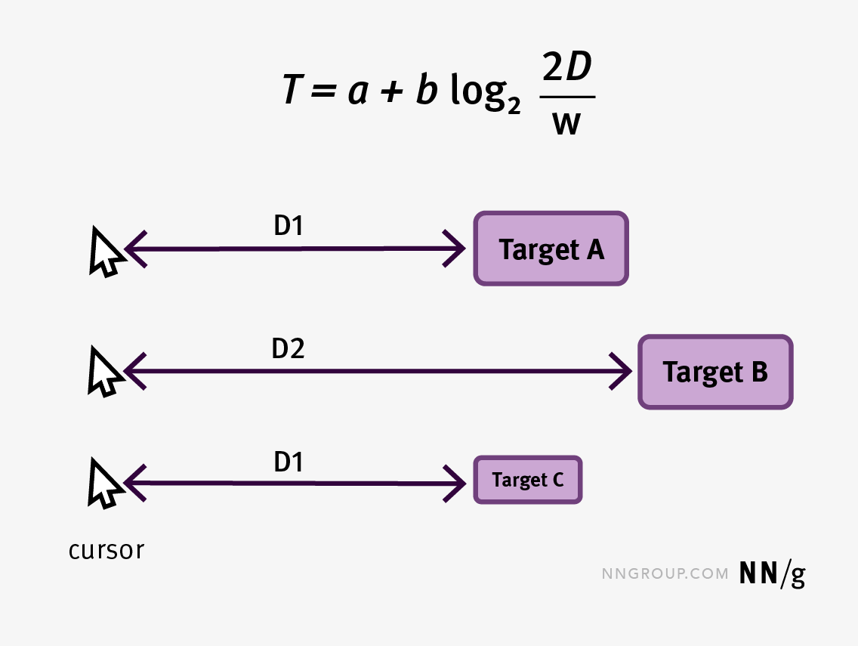
Fitt’s law
Time to reach the target
constants (type of pointer)
Target distance
Target width
the time to move your hand (with a mouse) depends logarithmically on the ratio of the target size to the distance you have to move the hand to hit the target - i.e. it is not a linear relationship
this law may help in deciding on sizes of more distant objects on the screen: they must be bigger
guidelines are hints - personal attitudes, abilities, tastes are important for designing a good interactive system - the designer should know the user and let him know that he cares...
https://www.nngroup.com/articles/fitts-law/
Notes:
A good example could be the changes that Microsoft made to the windows’ controls: minimize, full screen, exit. They are usually distant from where the cursor is when moving around the screen. So in the latest versions of Windows, they became bigger.

Slide 13
vagueness
users evolve: from naïve to experts, from naïve to informed, from children to grown-ups, from working in an office to working at home, etc.
vague principles allow designers to adhere to them without objective evaluation
but vagueness is dangerous...

Slide 14
Sorites paradox
an interactive system with no commands is not easy to use
adding a command to a difficult-to-use system does not make the system easy to use (adding a help command may make it easy to learn, not to use)
in this way no number of commands makes a system easy to use - the fault is that 'easy to use' is not predicated on the number of commands/that easy to use is a vague concept which, incidentally, does not help in designing a system having that property
Notes:
The paradox poses the question: If you have a heap of sand and you gradually remove one grain of sand at a time, when does the heap cease to be a heap? In other words, it challenges our understanding of concepts that lack clear, precise boundaries.

Slide 15
principle of least astonishment
problems arise at boundary conditions, the idea is to surprise the user as little as possible, particularly when entering new modalities/exceptions/difficult conditions for the user
for whom is astonishment minimized? subjective criteria
performance against uniformity - not everything may be undone...
Notes:
The "Principle of Least Astonishment" (“minor stupore”) is a design principle that suggests that when designing user interfaces or systems, you should minimize the extent to which users are surprised or astonished by the behavior of the system.

Slide 16
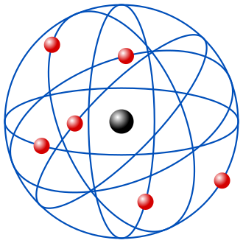
new orientation
some people can both establish and use the rules for working - interface design has one person designing another using the result of such design
good interactive systems are born by inspiration - guided by formal considerations - partly by ad hoc accretion...generally a coherent system does NOT result which means difficulties to introduce the system to new users, particularly if they are casual or non-experts
Rutherford said that a scientist does not really know what he is doing, unless he can explain his work to the laboratory cleaner...
guidelines should be accessible to both the designer and the user

Slide 17
GUEPS: a way to model principles
Thimbleby introduced the concept of generative user engineering principles (GUEPS). These principles have several properties:
They apply to a large class of different systems. That is they are generic.
They can be given both an informal colloquial statement and also a formal statement.
They can be used to constrain the design of a given system. That is they generate the design.
Notes:
https://harold.thimbleby.net/cv/files/guep.pdf
https://alandix.com/academic/papers/hci88/

Slide 18
Modes
role of hidden information - interactive system modes which are generally used to increase versatility of the system, yet they create increasing confusion
mode: variable info in the computer system affecting the meaning of what the user sees and does - editing, scrolling, drawing, zooming, etc. within the same application - also called views
some people consider input modes but it is better to view i/o parametrically
Notes:
Hidden information can be valuable for decluttering the interface, providing context-sensitive options, and revealing advanced features when users require them. However, if not well-organized, it can lead to discoverability issues, where users struggle to find and utilize hidden features.
Modes example: in a drawing application, there might be different modes for drawing, selecting objects, and applying text. Each mode alters the behavior of the interface, allowing users to perform distinct actions.
Modes can increase the versatility of the system, but they can also introduce confusion, especially if users inadvertently switch modes or struggle to determine the current mode

Slide 19
mode features
typically the system gives no clue to the user about its present state or how it was reached (hidden info)
nobody agrees on what a mode is: info channel in psychology/classes in logic/peaks in statistical distributions...
mody systems can be used faster but ambiguity and complexity are the two main drawbacks
Notes:
Ambiguity arises because users may inadvertently switch modes or be unsure of the current mode. Complexity increases as more modes are introduced, making the system harder to learn and master.
Modes ambiguity: in a symbolic interface style word processor, “d” stands for “delete” or for the letter “d”? (Thimbleby https://www.sciencedirect.com/science/article/pii/S0020737382800576)

Slide 20
low mode or modeless?
strictly speaking, a modeless system cannot work! it should be switched on - which is a ≠ mode from the off condition
yet, modelessness is perceived as a quality - in fact low mode systems is a more adequate name: the user does not perceive the modes and works without effort
a public-access system is truly modeless: a kiosk may be always on with a few buttons for fixed queries on local information

Slide 21
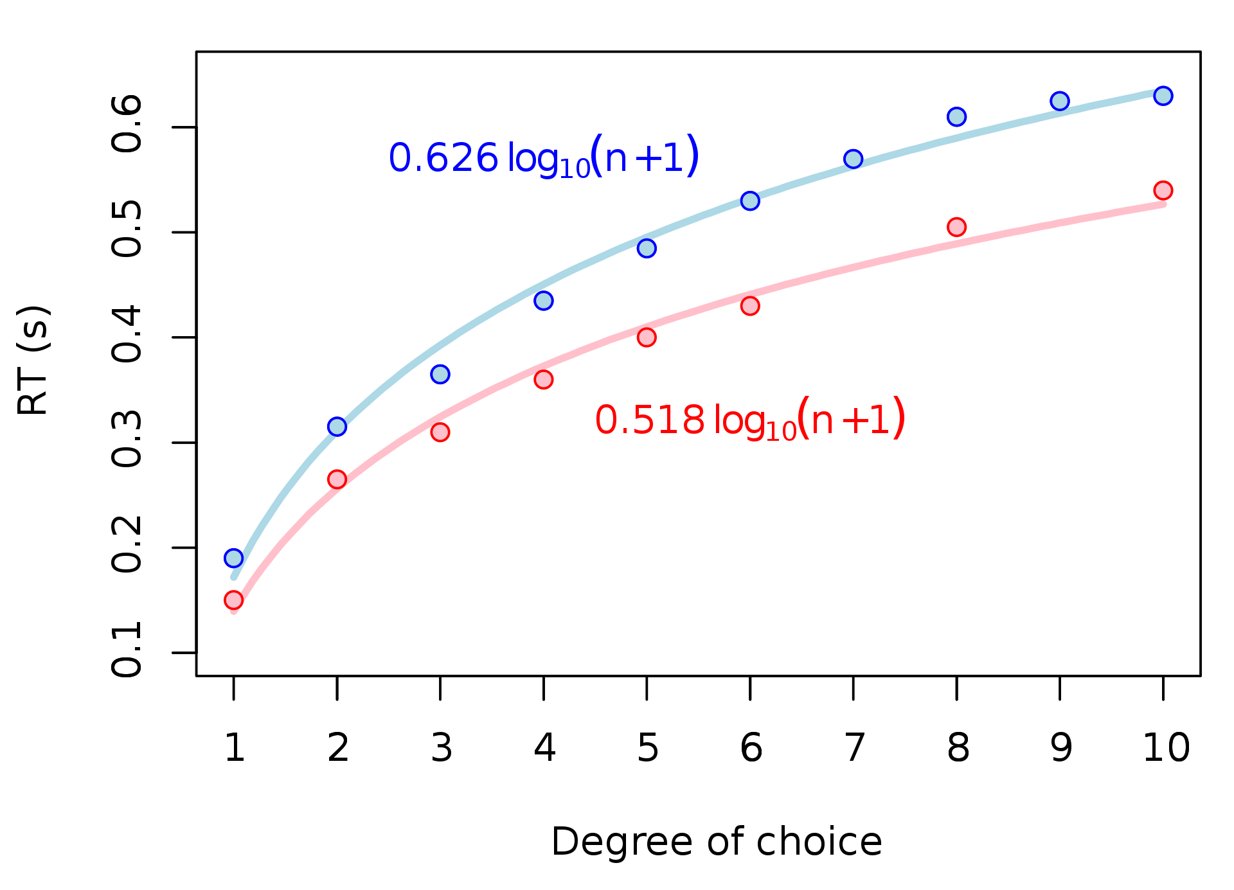
Modes: a negative issue
if too many modes, the user loses track...difficult to remember in which mode he is - Hick's Law (1952) states that “the user's decision time is logarithmic with the number of choices known to him”...sometimes the user does not know such number nor the exact meaning of each choice
https://en.wikipedia.org/wiki/Hick's_law
Notes:
videogames example: simulators, where to account for the scarcity of mapping between “real” and “virtual” control, the interface presents many modes -> simulators have indeed a steep learning curve.

Slide 22
spatial, temporal modes
why modes? because we only have about 70 keys on the keyboard, a small screen and a small bandwidth for the i/p medium (fingers/keys) with a large bandwidth for the o/p medium (eyes/screen)
slow transmission results when using few keys, fast transmission for a large number of them occupying a larger space (time vs space) but there is graceful degradation if time is chosen while abrupt degradation exists for a space choice
the mode in the user head may be out of pace with the mode in the computer system...
meaning of the mouse button depends on where the mouse is pointing: spatial mode instead of temporal mode
Notes:
time-based mode: ctrl+v (you have to press them both at the same time); shif+A to write capital ‘A’ is slow transmission because you have to press shift first, it will pass some time and then you will press A.
space-based mode: if the mouse is moved away from the canvas you move from a brush tool mode to a pointer mode, it is fast transmission because when you enter the canvas it will abruptly change the mode (the same goes for mode-bindend icons like ‘pencil mode’ or ‘pointer mode’)

Slide 23
cumbersome modes...
it is difficult to provide cues (visual, aural) to the user to remind him or tell him in which mode he is moving around
temporal modes appear when pressing a button on the mouse has a meaning depending on the menu choice (transient spatial), if no button is pressed the system reverts to a basic mode so giving a robust feeling to the user
Notes:
For example, if the user selected a "Copy" option from the menu, clicking the left mouse button after activation will copy the item the cursor is positioned over. If "Paste" is selected, clicking will paste content where the cursor is positioned.

Slide 24
illustrating modes
a backspace character may be misleading: what does it mean if it shows on the screen? what happens to existing characters? etc.
let us consider a 4-function calculator:
the display is used for many different things at different times and there is no way for the user to tell which one except by remembering what he has done in the recent past...
some significant info is never displayed and the user always has to remember...

Slide 25
the calculator example
this calculator has 20 buttons, the On button has no use except to switch the calculator on until we want, and to switch it off by pressing the Off button
if you want to use this calculator and nothing is displayed press On, a 0 will be displayed
if the user hits a digit (except for 0) such value is added to the display appearing from the right - as if we multiply each time by 10 - in fact adding 0 and multiplying it by 10 it is still 0
if the decimal point is hit (second button from the left in the bottom row) then numbers are divided by 10 until the display is full

Slide 26
trying to use the calculator
what happens next (if display is full) depends on whether the user hits the decimal point: if no, the display gets jammed up, the C button must be pressed and a 0 reappears, if yes further digits are ignored and the display remains as it was
so far it is difficult but understandable due to the knowledge users have of number representation and manipulation
1234
On
Off
AC
C
7
8
9
/
4
5
6
x
1
2
3
-
0
.
+
=

Slide 27
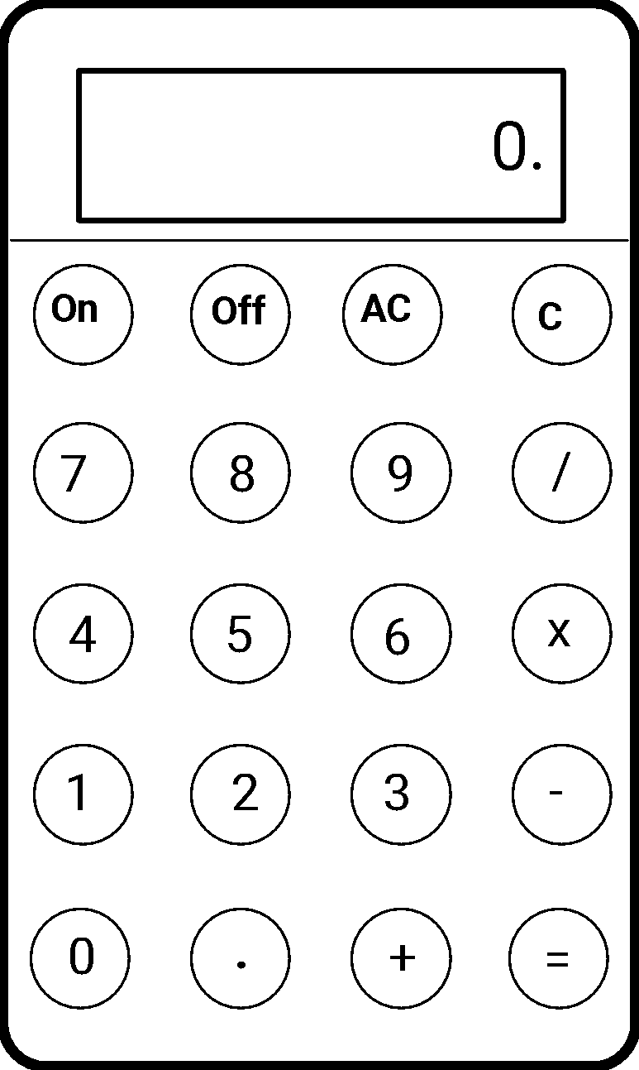
understanding the calculator
if an arithmetic button is pressed, there is no effect but when another digit is pressed a new number appears - what is hidden (because we have only one display) is the fact we are working with 2 numbers:
1 number being entered by user
2 number representing the running calculation
suppose we have a value (partial result) on the display, we press + and then another number = the total result (adding the new number to the previous value)

Slide 28
bi-modal calculator
1) hitting a digit: display changes to current number
2) hitting an operator: display changes to calculation
since buttons generally give no feedback, they are small, may be pressed too lightly, etc. the user is never certain whether he has pressed the button strongly enough, so
there is confusion about which value is displayed: the current number or the running calculation?
this calculator has 2 modes but there is no way to tell!

Slide 29
how many modes?
other calculators have even more modes: pressing an operator twice means that the running calculation may be copied to the constant register, if / is pressed twice it may mean a different operator (the inverse), special keys perform percentages, etc.
there is no way to find out which mode the calculator is in, without affecting it (invasive check-out)

Slide 30
inertial modes
the system is able to fill-in details by defaulting them, info provided by default is hidden - there are also user-supplied defaults
square width ? 1.2471 enter
...
square width ? 1.2471? enter
this is a mechanism of passive recall since the system will ask the user - by default - if the value he now wants is the same as the previous one (default value)
Notes:
Calculators are therefore inertial modes, that default previous user inputs.
With passive recall the default values are showed again to the user for confirmation.
This can be a useful feature in various applications, particularly in scenarios where users perform repetitive tasks or need to enter similar values repeatedly.
Ex: 2 -> + -> 2 -> = … 2+2?

Slide 31
inertial dangers
defaulting is not a good choice if the result is irreversible
some menus require two actions:
1-choice and
2-confirmation, the last choice is inertial - the default choice is the last one the user selected
the same happens when using many menus - one after another - going back one step to a previous menu will provide the same choice made in a previous session (this is the default value)
some forms of modiness may turn useful and are called inertial yet sometimes the user is disoriented or cannot do what he wants - then we have modes

Slide 32
gueps for modes
input modes
the user submits q in one mode it may mean QUIT, in another “type q “ corresponds to another mode which may mean an ERROR; the corresponding guep indicates that a good interactive system is one which is so consistent and predictable that it may be used without looking at the screen
if there is more than one mode, the user may switch from one to another by fixed mode-independent command sequences
for instance, escape will take the user to a fixed state - external to the currently running application - even if that action is submitted a number of times...this is the idempotence property (escape escape = escape )
Notes:
mode-independent command example: alt+tab

Slide 33
pre-emptive modes
for outlawing pre-emptive modes you may have a guep saying: "you may do anything anywhere"
for non pre-emption:
using a temporal feature: every user-command can be entered if prefixed by a cursor (! for instance)
using a spatial feature: with ≠ windows popping up one may change mode in another part of the screen, typically inside a new window
Notes:
Pre-emptive modes refer to situations in which the system can change its mode without the explicit consent or command of the user.
To outlaw pre-emptive modes, a generative user-engineering principle (GUEP) could be defined as "you may do anything anywhere."
This principle suggests that the user should have the freedom to perform any action or command in any context without the system changing modes automatically.
This means that the system should not switch modes or alter its behavior without the user's explicit input or command. The user retains control over the system's behavior at all times.
In systems with multiple windows or interfaces, each window may represent a specific mode or context. When the user interacts with elements within a particular window, it implies that they are operating in that mode.
To change the mode, the user can interact with elements or controls within a different window. This spatial separation allows the user to transition between modes within specific regions of the screen.

Slide 34
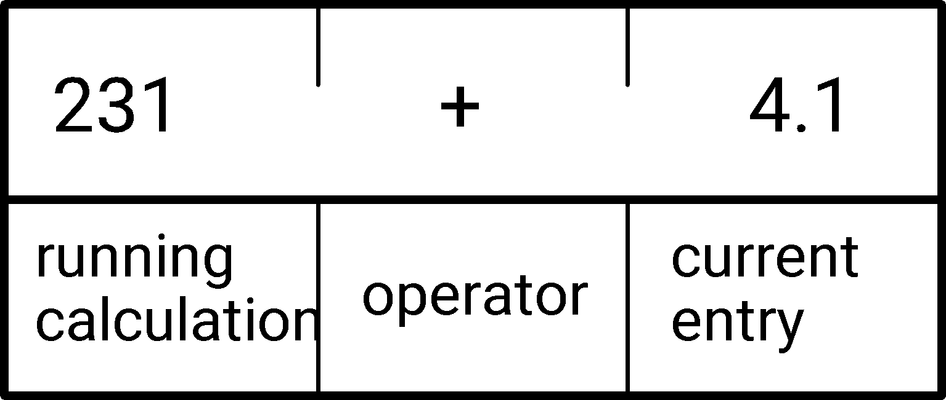
output modes
the o/p mode is typically dependent on the history
in the calculator case an imperative paradigm was used and 2 modes were present; if the system was declarative, no ≠ modes are necessary, the user may be guided only by what he can see (on the display) / showing what is relevant

Slide 35
a better calculator interface
in this way, the user can do sums on what he can see alone - a good design would show all of the calculation that is relevant to the user
nothing is hidden - every button has a well defined meaning which is shown on the display
the only relevant entities are those that can be perceived - the "=" button is now redundant
Notes:
Ex: online unit of measure converters

Slide 36
WYSIWYG
What You See Is What You Get (wizzy-wig) = no hidden info
previously, for a text processor/editor one had commands (.CENTRE) for centring a line, but the only way to see the effect was to print the line
ww avoids the problems of programming "blindly" to format the text as wanted but limits the control of a sophisticated programmer
a compromise is to have ww for simple things and free programming for advanced features
ww pushes both designer and user to share conceptualization of the interactive system
the good features of a ww system which make it easy to use are tedious for an expert to use
Notes:
LateX vs Word

Slide 37
WW
in ww you always see the end result, the user may concentrate on contents and then on form or viceversa - the system is underdetermined, you cannot see the history, i.e. the evolution of the formatting process, the process of improving a drawing (inside a text) is one of always editing the last version since the first one is lost
some of these problems may be solved with undo and redo

Slide 38
domain independence?
a good guep is to ignore the application when designing the interface
in ww we consider a style for interactive text processing systems but could also hold for drawing or for any application which will print out what one is obtaining as a result on the screen

Slide 39
menu systems
menu systems are WYSIWYG - based, all choices are given but if more than those shown are available then we do not have WYSIWYG any more!
if typing a number which is higher than those indicating the different menu choices produces a result (unexpected) this - again - is not WYSIWYG style
all choices should be visible on the screen when selecting the menu label on top of the different possible paths

Slide 40
interpretation of commands
task structuring is a guide to modes
commands of a non-modey system (single mode) change the system state
they map the current state into the next state which may formally be written as
I [c ] ∈Σ → S meaning that the Interpretation of the command c changes the current state of the system to the next State
as an example, imagine we type
i to a word processor, its meaning is
I [i ] ∈Σ → S changing the state of the word processor into the next state
Notes:
I[c]∈Σ→S
Where:
I[c]: Represents the interpretation of the command c.
Σ: Denotes the set of possible commands or actions.
S: Represents the state of the system.

Slide 41
for the calculator case
suppose we are now entering number 5 into a calculator - meaning multiply whatever is on the display (s ) by 10 and adding 5 to it (if nothing is on the display 0x10=0)
I [5 ] = s ⇒ 10s + 5
in general
I [d ] = s ⇒ 10s + val(d )
but if the system is modey a command may both change the state of the system and its mode, i.e. the meanings of the commands that follow
Notes:
Longer explanation:
In the notation I[d] = s ⇒ 10s + val(d), I is the interpretation of the command d. The interpretation maps the input symbols in Σ to a set of states in S that satisfy the condition c. Here, d is a digit that is entered into the calculator, and s is the current state of the calculator display.
The constraint I[d] = s ⇒ 10s + val(d) specifies that when the digit d is entered into the calculator, the state of the calculator changes to 10s + val(d), where val(d) is the numerical value of the digit. For example, if the current state of the calculator display is 3, and we enter the digit 5, then the new state of the calculator display will be (10 * 3) + 5 = 35.
However, if the system is modey, then a command may change both the state of the system and its mode. In this case, the meanings of subsequent commands may be different depending on the current mode. For example, if we consider a calculator that has two modes: addition and subtraction, then entering a digit in each mode may have different meanings. In addition mode, entering a digit may add it to the current state of the calculator display, while in subtraction mode, entering a digit may subtract it from the current state.

Slide 42
seeing through modes
a mode information must also be taken into account (m ∈ M) for the interpretation of a command
I [c ] m ∈ S → (SxM) or equivalently
I [c ] m → (SxM) → (SxM)
example: a calculator may operate in "decimal" mode or in "hexadecimal" mode, the input digit does not alter the mode m (10 or 16)
I [d ] m = s ⇒ (ms + val(d ), m)
Notes:
For example, if the current state of the calculator display is 3, and we enter digit 5 in decimal mode, then the new state of the calculator display will be (10 * 3) + 5 = 35. If we enter digit A (which corresponds to 10 decimal) in hexadecimal mode, then the new state will be 3A (in decimal (16 * 3) + 10 = 58).

Slide 43
insert or type?
another example: a word processor may use i as a command for "insert" or i as a letter to be written in the text ... very confusing!
I [i ] m = s ⇒ (s '+ val(i ), m+1)
the i key has a meaning which depends on where it is inserted and it affects the meaning of the subsequent commands, the cursor position being represented by m
if we have typed i what happens next is that any letter will be inserted to the right of the cursor position (m+1), s' would be the new state based on the old s but including the letter i at position m
Notes:
here the Interpretation of a command is both the command of inserting a new value to the next cursor position (m+1) and the value of the command itself (‘i’).

Slide 44
solution
the cursor position is always visible to the user, we could include it in the state S so as to make the word processor modeless, in this case we would have
I' [c ] ∈S' → S ' where S'= SxM this new state set conceals the mode M and now I' has a modeless form
Notes:
Here we make the mode for the cursor position a state of the system, thus removing it (modeless) from the user’s perspective by concealment.

Slide 45
bottlenecks locate modes
to what extent can the mode be treated as a part of the system's state? the state can be factored in many ways...
perhaps we may define the mode as a dependence on any info, data or procedure that is not apparent to the user (usability point of view)
I' [c ] ∈S' → S ' is modeless but if the component M of S' is concealed to the user then, the system is modey
what to conceal and what to show this is Hamlet's dilemma in interface design
Notes:
Non-apparent information includes internal details, system states, or algorithms that are not relevant to the user's primary tasks. When these non-apparent aspects affect how commands are interpreted, they can be considered part of the mode. In some cases, concealing mode information simplifies the user's experience. However, complete transparency might be necessary when mode changes directly affect user interactions.

Slide 46
Some conclusions
the quickest way to make something incomprehensible is to conceal something from the user, even better if what is concealed keeps changing: modes
information not transferred between user & computer increases modiness
WYSIWYG is a protypical guep
the user is inspired to confidence (no hidden tricks)
system model can be understood
user may generalize his knowledge
"out of sight out of mind": if something is out of sight make sure the user can operate with it out of mind

